Slide 1
Business Process Engineering

Slide 2
What organization want
Developing global capacity.
Positioning for growth.
Relentless business improvement.
Managing from the outside in.

Slide 3
What is productivity or relentless business improvement?
doing things faster for less cost
Quality must also be added into this equation
Another measure of productivity is the rate at which an organization is responsive to service or product innovation

Slide 4
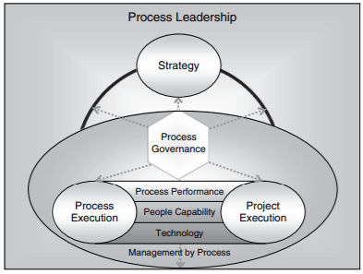
Management by Process framework

Slide 5
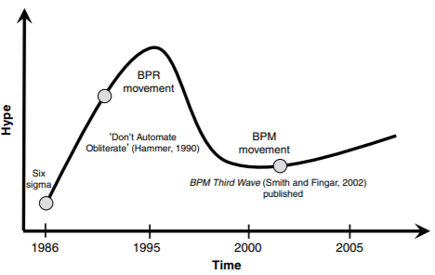
BPM hype cycle.

Slide 6
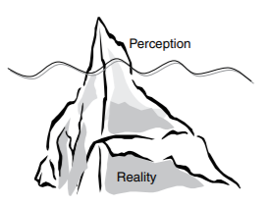
The iceberg syndrome

Slide 7
What is business process management?
BPM does not equate to a technology tool or initiative for business processes.
There is significant business process improvement that can be achieved without technology.
“The achievement of an organization’s objectives through the improvement, management and control of essential business processes”

Slide 8
BPM is:
• more than just software
• more than just improving or reengineering your processes – it also deals with the managerial issues
• not just hype – it is an integral part of management
• more than just modeling – it is also about the implementation and execution of these processes, which requires analysis.

Slide 9
Definition
1- A business process consists of a set of activities that are performed in coordination in an organizational and technical environment. These activities jointly realize a business goal.
2- Business process management includes concepts, methods, and techniques to support the design, administration, configuration, enactment, and analysis of business processes.
3- A business process management system is a generic software system that is driven by explicit process representations to coordinate the enactment of business processes.

Slide 10
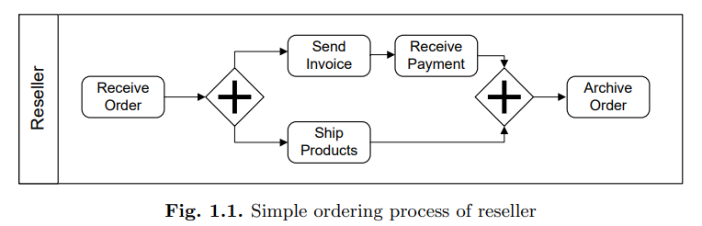
Simple process example

Slide 11
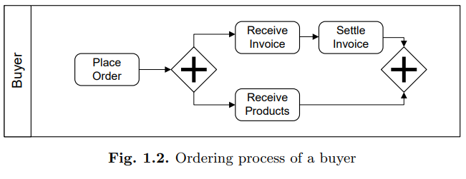

Slide 12
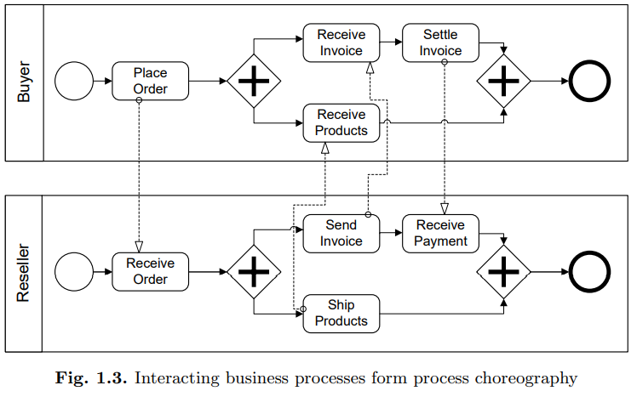
Interaction behavior

Slide 13
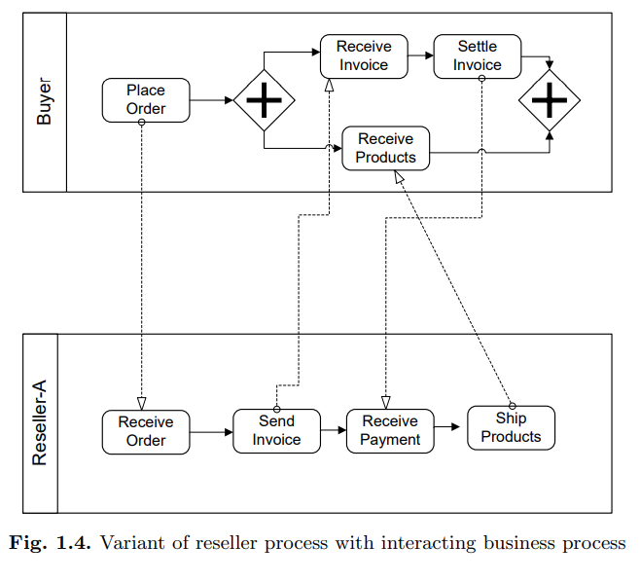

Slide 14
Business Process Lifecycle Phase 1: Design and Analysis
Surveys on the business processes
Organizational and technical environment
Based on these surveys, business processes are identified, reviewed, validated, and represented by business process models.
Business process modelling techniques as well as validation, simulation, and verification techniques are used during this phase.
Once an initial design of a business process is developed, it needs to be validated.
Simulation techniques can be used to support validation, because certain undesired execution sequences might be simulated that show deficits in the process model.

Slide 15
Phase 2: Configuration
Once the business process model is designed and verified, the business process needs to be implemented.
It can be implemented by a set of policies and procedures that the employees of the enterprise need to comply with.
In case of software, an implementation platform is chosen during the configuration phase.

Slide 16
Phase 3: Enactment
The process enactment phase encompasses the actual run time of the business process.
Business process instances are initiated to fulfil the business goals of a company.

Slide 17
Phase 4: Evaluation
The evaluation phase uses information available to evaluate and improve business process models and their implementations.
Execution logs are evaluated using business activity monitoring and process mining techniques.
These techniques aim at identifying the quality of business process models and the adequacy of the execution environment.

Slide 18
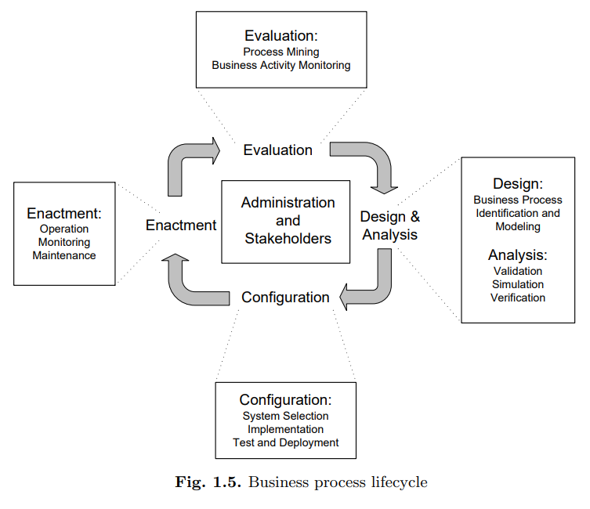

Slide 19
Stakeholders in BPM
Chief Process Officer: The chief process officer is responsible for standardizing and harmonizing business processes in the enterprise.
In addition, he or she is responsible for the evolution of business processes in the presence of changing market requirements.
Installing an explicit role of chief process officer acknowledges the importance of business process management at the top level of management.

Slide 20
Business Engineer : Business engineers are business domain experts responsible for defining strategic goals of the company and organizational business processes.
Often, business engineers have a nontechnical educational background, so that convenient and simple-to-use process modelling notations are required to communicate about business processes with these stakeholders.

Slide 21
Process Designer : Process designers are responsible for modelling business processes by communicating with business domain experts and other stakeholders.
Very good analytical capabilities and excellent communication skills are important for a process designer

Slide 22

Process Participant: Process participants conduct the actual operational work during the enactment of business process instances.
They also play an important role during business process modelling, because they are knowledgeable about the activities conducted and their interrelationships with activities conducted by other process participants.
It is the task of the process designer to assemble from this information a consistent overall view and capture it as a business process model.

Slide 23
Knowledge Worker : Knowledge workers are process participants who use software systems to perform activities in a business process.
Knowledge workers are equipped with detailed knowledge of the application domain, and they can perform activities, or even parts of business processes, autonomously.

Slide 24
Process Responsible: Each business process model is assigned an individual who is responsible for the correct and efficient execution of all business processes using this model.
He or she is responsible for detecting inefficiencies in the process and for improving it, in close collaboration with the process participants and the process designers.

Slide 25

System Architect: System architects are responsible for developing and configuring business process management systems so that the configured business process management system enacts the business processes in the context of the information systems infrastructure at hand.

Slide 26
Developers: Developers are information technology professionals who create software artefacts required to implement business processes.
The implementation of interfaces to existing software systems is an important area of work for developers.

Slide 27
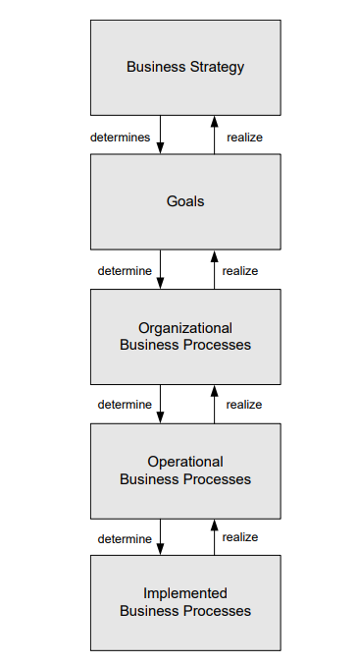
Classification of Business Processes Organizational versus Operational

Slide 28
Intra organizational Processes versus Process Choreographies
If there is no interaction with business processes performed by other parties, then the business process is called Intra organizational.
Most business processes, however, interact with business processes in other organizations, forming process choreographies.

Slide 29
Degree of Automation
Semi and Fully Automated processes.
May have or NO human is involved in the enactment of such a business process.
Enterprise application integration is another area where automated business processes can be found.
The goal is to integrate the functionality provided by a heterogeneous software landscape, i.e Service Oriented Architecture.

Slide 30
Degree of Repetition
Highly repetitive business processes: no human interaction.
Frequent business processes: processes in which humans are involved.
Collaborative business processes: The collaboration between the persons involved is at the center of attention.
Business processes with a low degree of repetition are often not fully automated and have a collaborative character, so that the effort in providing automated solutions is not required, which lowers the cost.

Slide 31
Degree of Structuring
Structured: If the business process model prescribes the activities and their execution constraints in a complete fashion, then the process is structured.
Production workflows are well structured and highly repetitive
Traditional workflow management system functionality is well suited to supporting production workflows.
Ad-hoc: Define processes in a less rigid manner.
Activities can be executed in any order or even multiple times until the knowledge worker decides.
Unstructured

